Slide 1
Polygon Basics
Ms. Mougharbel

Slide 2
Naming Polygons: Latin meets Greek
Name | How many sides
Monogon | 1
Digon | 2
Trigon (Triangle) | 3
Tetragon (Quadrilateral) | 4
Pentagon | 5
Hexagon | 6
Heptagon | 7
Octagon | 8
Nonagon | 9
Decagon | 10

Slide 3
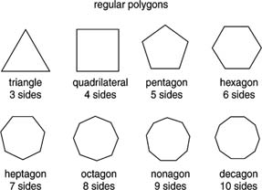

Slide 4
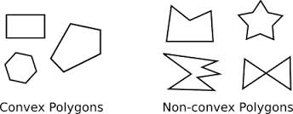
Convex or Concave
Convex Polygon
All interior sides are less than 180°
Concave Polygon
At least one interior angle is greater than 180°

Slide 5
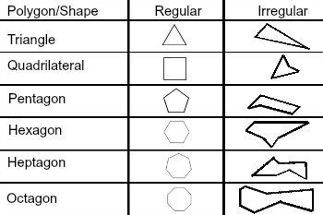
Regular or Irregular
Regular Polygons: Have all sides equal length
·
Irregular Polygons: Can have sides of any length and angles of any size

Slide 6
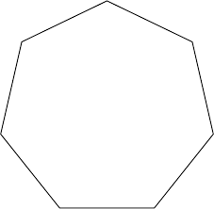
Solving for an interior angle of a regular polygon
n = the number of sides of the regular polygon
Single interior angle$=\frac{\left(n−2\right)\left(180\right)}{n}$
$\frac{\left(\left(7\right)−2\right)\left(180\right)}{7}=$
$\frac{\left(5\right)\left(180\right)}{7}$=
$\frac{900}{7}$= 128.6º

Slide 7

Solving for an exterior angle of a regular polygon
Single Exterior Angle = $\frac{360}{n}$
360/7 = 54.4º

