Slide 1
polygons
Geometry – Ms. Mougharbel

Slide 2
Classifying Polygons
What is a polygon?
a plane figure with at least three straight sides and angles, and typically five or more.

Slide 3
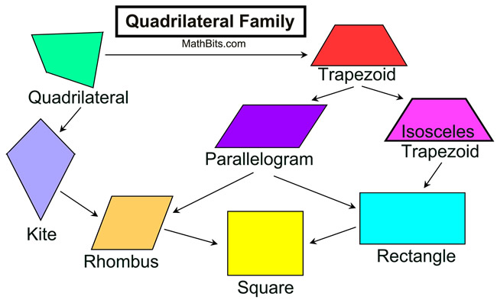
Quadrilateral
A Flat shape with four straight sides
The most general term for all four sided polygons

Slide 4
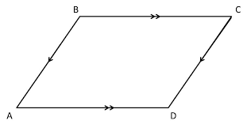
Parallelogram
A four sides plane rectilinear figure with opposite sides parallel

Slide 5
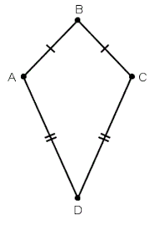
Kite
Has two pairs of equal sides. Each pair must be adjacent sides (sharing a common vertex) and each pair must be distinct.
Yes, it looks like a kite

Slide 6
Rectangle
A 4-sided flat shape with straight sides where all interior angles are right angles (90°). Also opposite sides are parallel and of equal length.

Slide 7
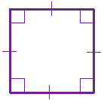
Square
regular quadrilateral, which means that it has four equal sides and four equal angles

Slide 8
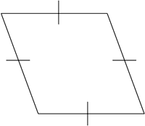
Rhombus
A 4-sided flat shape with straight sides where all sides have equal length. Also opposite sides are parallel and opposite angles are equal. It is a type of parallelogram.

Slide 9
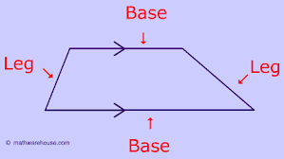
Trapezoid
A 4-sided flat shape with straight sides that has a pair of opposite sides parallel. The sides that are parallel are called "bases".

Slide 10
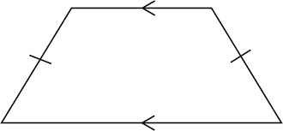
Isosceles Trapezoid
when both angles coming from a parallel side are equal, and the sides that aren't parallel are equal in length.

Slide 11
What do you think their angles must add up to?

Slide 12
360 Degrees! =D

Slide 13
Practice Problems! =p

