Slide 1
Essentials of Human Anatomy & Physiology
Seventh Edition
Elaine N. Marieb
Chapter 11 The Cardiovascular System
Copyright © 2003 Pearson Education, Inc. publishing as Benjamin Cummings

Slide 2
The Cardiovascular System
A closed system of the heart and blood vessels
The heart pumps blood
Blood vessels allow blood to circulate to all parts of the body
The function of the cardiovascular system is to deliver oxygen and nutrients and to remove carbon dioxide and other waste products
Copyright © 2003 Pearson Education, Inc. publishing as Benjamin Cummings
Slide 11.1

Slide 3
The Heart
Location
Thorax between the lungs
Pointed apex directed toward left hip
About the size of your fist
Less than 1 lb.
Copyright © 2003 Pearson Education, Inc. publishing as Benjamin Cummings
Slide 11.2a

Slide 4
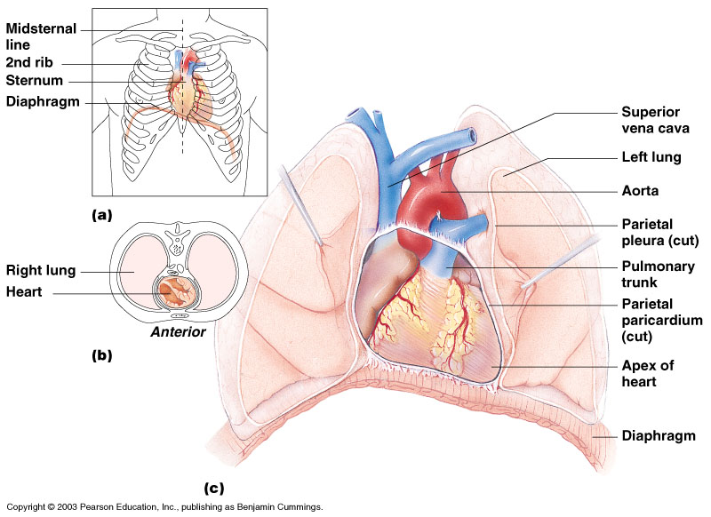
The Heart
Figure 11.1
Copyright © 2003 Pearson Education, Inc. publishing as Benjamin Cummings
Slide 11.2b

Slide 5
The Heart: Coverings
Pericardium – a double serous membrane
Visceral pericardium
Next to heart
Parietal pericardium
Outside layer
Serous fluid fills the space between the layers of pericardium
Copyright © 2003 Pearson Education, Inc. publishing as Benjamin Cummings
Slide 11.3

Slide 6
The Heart: Heart Wall
Three layers
Epicardium
Outside layer
This layer is the parietal pericardium
Connective tissue layer
Myocardium
Middle layer
Mostly cardiac muscle
Endocardium
Inner layer
Endothelium
Copyright © 2003 Pearson Education, Inc. publishing as Benjamin Cummings
Slide 11.4

Slide 7
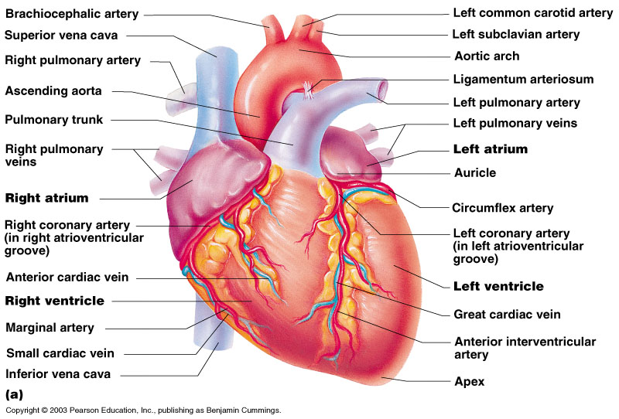
External Heart Anatomy
Copyright © 2003 Pearson Education, Inc. publishing as Benjamin Cummings
Figure 11.2a
Slide 11.5

Slide 8
The Heart: Chambers
Right and left side act as separate pumps
Four chambers
Atria
Receiving chambers
Right atrium
Left atrium
Ventricles
Discharging chambers
Right ventricle
Left ventricle
Copyright © 2003 Pearson Education, Inc. publishing as Benjamin Cummings
Slide 11.6

Slide 9
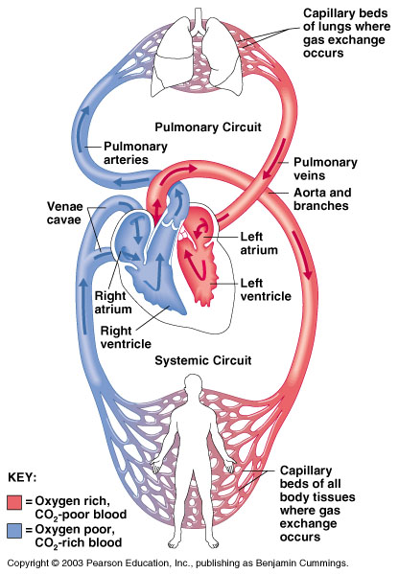
Blood Circulation
Figure 11.3
Copyright © 2003 Pearson Education, Inc. publishing as Benjamin Cummings
Slide 11.7

Slide 10
The Heart: Valves
Allow blood to flow in only one direction
Four valves
Atrioventricular valves – between atria and ventricles
Bicuspid valve (left)
Tricuspid valve (right)
Semilunar valves between ventricle and artery
Pulmonary semilunar valve
Aortic semilunar valve
Copyright © 2003 Pearson Education, Inc. publishing as Benjamin Cummings
Slide 11.8

Slide 11
The Heart: Valves
Valves open as blood is pumped through
Held in place by chordae tendineae (“heart strings”)
Close to prevent backflow
Copyright © 2003 Pearson Education, Inc. publishing as Benjamin Cummings
Slide 11.9

Slide 12
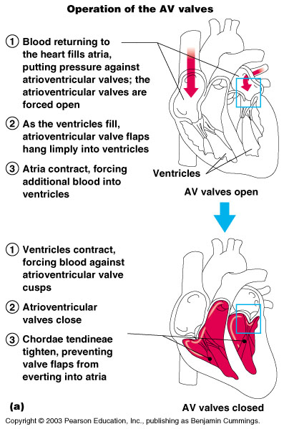
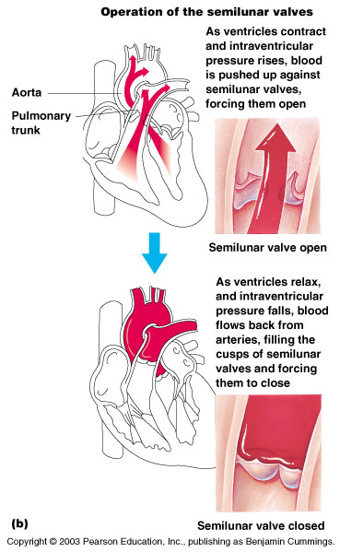
Operation of Heart Valves
Figure 11.4
Copyright © 2003 Pearson Education, Inc. publishing as Benjamin Cummings
Slide 11.10

Slide 13
Valve Pathology
Incompetent valve = backflow and repump
Stenosis = stiff= heart workload increased
May be replaced
Lup Dub Heart Sound

Slide 14
The Heart: Associated Great Vessels
Aorta
Leaves left ventricle
Pulmonary arteries
Leave right ventricle
Vena cava
Enters right atrium
Pulmonary veins (four)
Enter left atrium
Copyright © 2003 Pearson Education, Inc. publishing as Benjamin Cummings
Slide 11.11

Slide 15
Coronary Circulation
Blood in the heart chambers does not nourish the myocardium
The heart has its own nourishing circulatory system
Coronary arteries
Cardiac veins
Blood empties into the right atrium via the coronary sinus
Copyright © 2003 Pearson Education, Inc. publishing as Benjamin Cummings
Slide 11.12

Slide 16
Cardiac Pathology
Rapid heart beat
= Inadequate blood
(What would cause this?)
= Angina Pectoris
(This is a sign of a Myocardial Infarction)

Slide 17
The Heart: Conduction System
Intrinsic conduction system (nodal system)
Heart muscle cells contract, without nerve impulses, in a regular, continuous way
Copyright © 2003 Pearson Education, Inc. publishing as Benjamin Cummings
Slide 11.13a

Slide 18
The Heart: Conduction System
Special tissue sets the pace (What tissue?)
Sinoatrial node (right atrium)
Pacemaker
Atrioventricular node (junction of r&l atria and ventricles)
Atrioventricular bundle (Bundle of His)
Bundle branches (right and left)
Purkinje fibers
Copyright © 2003 Pearson Education, Inc. publishing as Benjamin Cummings
Slide 11.13b

Slide 19
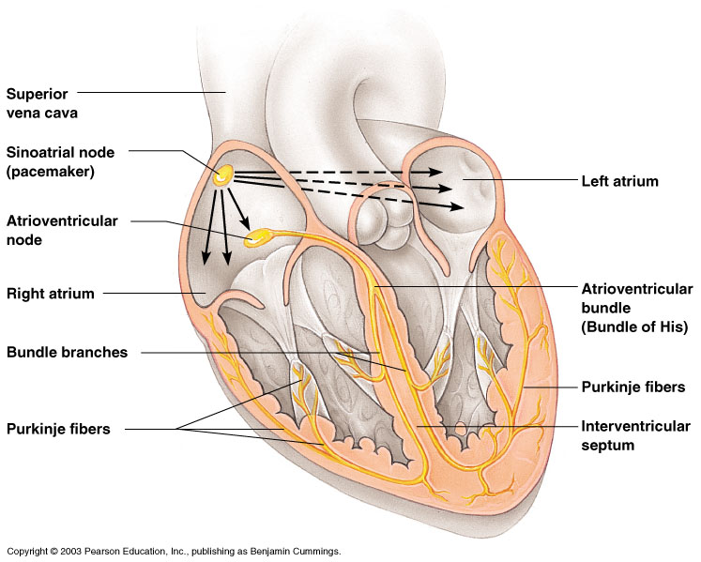
Heart Contractions
SA Node → AV Node → AV Bundle → Bundle Branches → Purkinje Fibers
Figure 11.5
Copyright © 2003 Pearson Education, Inc. publishing as Benjamin Cummings
Slide 11.14b

Slide 20
Electrocardiograms (EKG/ECG)
Three formations
P wave: impulse across atria
QRS complex: spread of impulse down septum, around ventricles in Purkinje fibers
T wave: end of electrical activity in ventricles

Slide 21
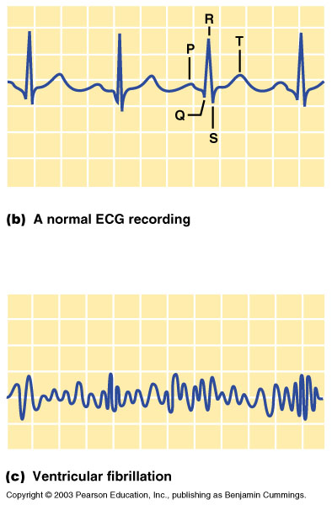
Electrocardiograms (EKG/ECG) (cont.)
Figure 8.15B, C

Slide 22
Pathology of the Heart
Damage to AV node = release of ventricles from control = slower heart beat
Slower heart beat can lead to fibrillation
Fibrillation = lack of blood flow to the heart
Tachycardia = more than 100 beats/min
Bradycardia = less than 60 beats/min

Slide 23
Recap!
Where is the heart located?
Visceral Pericardium vs Parietal Pericardium
Name the four chambers of the heart
What is the function of each heart valve?
What is the path of blood through the heart?
Which vessel supplies blood to the myocardium?
What cause heart sounds “Lub – Dub”?
What is the cardiac impulse pathway starting from the SA Node?
What is an ECG/EKG?
What does each wave represent?

Slide 24
Bellwork 3/4/19
Please read page 361 “Exercise and the Cardiovascular System,” and answer the following questions.
What is your max. heart rate?
Is it okay for sedentary people to start vigorously exercising right away? Why or why not?

Slide 25
The Heart: Cardiac Cycle
Atria contract simultaneously
Atria relax, then ventricles contract
Systole = contraction
Diastole = relaxation
Copyright © 2003 Pearson Education, Inc. publishing as Benjamin Cummings
Slide 11.16

Slide 26
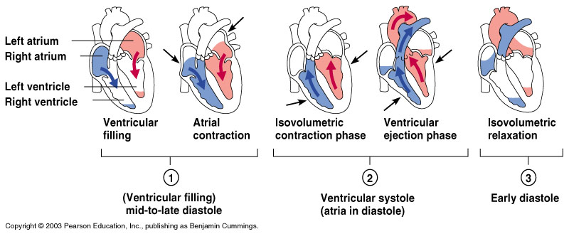
Filling of Heart Chambers – the Cardiac Cycle
Figure 11.6
Copyright © 2003 Pearson Education, Inc. publishing as Benjamin Cummings
Slide 11.15

Slide 27
The Heart: Cardiac Output
Cardiac output (CO)
Amount of blood pumped by each side of the heart in one minute
CO = (heart rate [HR]) x (stroke volume [SV])
Stroke volume
Volume of blood pumped by each ventricle in one contraction
Copyright © 2003 Pearson Education, Inc. publishing as Benjamin Cummings
Slide 11.18

Slide 28
Cardiac output, cont.
CO = HR x SV
5250 ml/min = 75 beats/min x 70 mls/beat
Norm = 5000 ml/min
Entire blood supply passes through body once per minute.
CO varies with demands of the body.

Slide 29
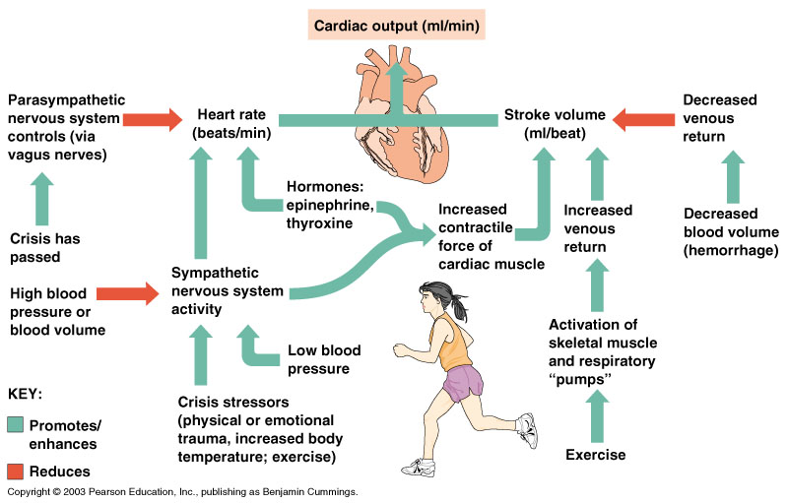
Cardiac Output Regulation
Figure 11.7
Copyright © 2003 Pearson Education, Inc. publishing as Benjamin Cummings
Slide 11.19

Slide 30
The Heart: Regulation of Heart Rate
Stroke volume usually remains relatively constant
Starling’s law of the heart – the more that the cardiac muscle is stretched, the stronger the contraction
Changing heart rate is the most common way to change cardiac output
Copyright © 2003 Pearson Education, Inc. publishing as Benjamin Cummings
Slide 11.20

Slide 31
Regulation of Heart Rate
Increased heart rate
Sympathetic nervous system
Crisis
Low blood pressure
Hormones
Epinephrine
Thyroxine
Exercise
Decreased blood volume
Copyright © 2003 Pearson Education, Inc. publishing as Benjamin Cummings
Slide 11.21

Slide 32
The Heart: Regulation of Heart Rate
Decreased heart rate
Parasympathetic nervous system
High blood pressure or blood volume
Dereased venous return
In Congestive Heart Failure the heart is worn out and pumps weakly. Digitalis works to provide a slow, steady, but stronger beat.
Copyright © 2003 Pearson Education, Inc. publishing as Benjamin Cummings
Slide 11.22

Slide 33
Congestive Heart Failure (CHF)
Decline in pumping efficiency of heart
Inadequate circulation
Progressive, also coronary atherosclerosis, high blood pressure and history of multiple Myocardial Infarctions
Left side fails = pulmonary congestion and suffocation
Right side fails = peripheral congestion and edema

Slide 34
Did you know?
Contraction of the human heart creates enough pressure to squirt blood 30 feet.

Slide 35
Blood Vessels: The Vascular System
Taking blood to the tissues and back
Arteries
Arterioles
Capillaries
Venules
Veins
Copyright © 2003 Pearson Education, Inc. publishing as Benjamin Cummings
Slide 11.23

Slide 36
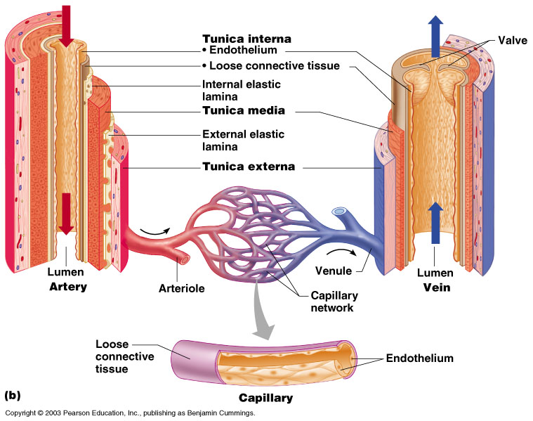
The Vascular System
Figure 11.8b
Copyright © 2003 Pearson Education, Inc. publishing as Benjamin Cummings
Slide 11.24

Slide 37
Blood Vessels: Anatomy
Three layers (tunics)
Tunic intima
Endothelium
Tunic media
Smooth muscle
Controlled by sympathetic nervous system
Tunic externa
Mostly fibrous connective tissue
Copyright © 2003 Pearson Education, Inc. publishing as Benjamin Cummings
Slide 11.25

Slide 38
Differences Between Blood Vessel Types
Walls of arteries are the thickest
Lumens of veins are larger
Skeletal muscle “milks” blood in veins toward the heart
Walls of capillaries are only one cell layer thick to allow for exchanges between blood and tissue
Copyright © 2003 Pearson Education, Inc. publishing as Benjamin Cummings
Slide 11.26
Notes:
Good matching question

Slide 39
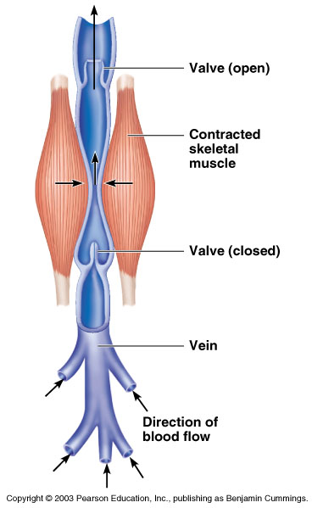
Movement of Blood Through Vessels
Most arterial blood is pumped by the heart
Veins use the milking action of muscles to help move blood
Figure 11.9
Copyright © 2003 Pearson Education, Inc. publishing as Benjamin Cummings
Slide 11.27

Slide 40
Did you know?
There are about 62,000 miles of blood vessels in the human body – enough to stretch 2 ½ times around the world

Slide 41
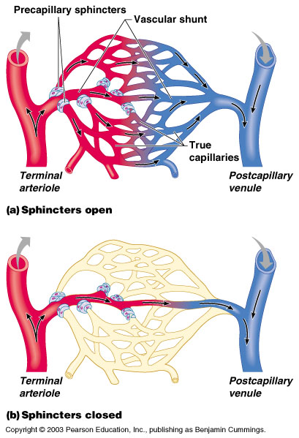
Capillary Beds
Capillary beds consist of two types of vessels
Vascular shunt – directly connects an arteriole to a venule
Copyright © 2003 Pearson Education, Inc. publishing as Benjamin Cummings
Figure 11.10
Slide 11.28a

Slide 42
Capillary Beds
True capillaries – exchange vessels
Oxygen and nutrients cross to cells
Carbon dioxide and metabolic waste products cross into blood
Copyright © 2003 Pearson Education, Inc. publishing as Benjamin Cummings
Figure 11.10
Slide 11.28b

Slide 43
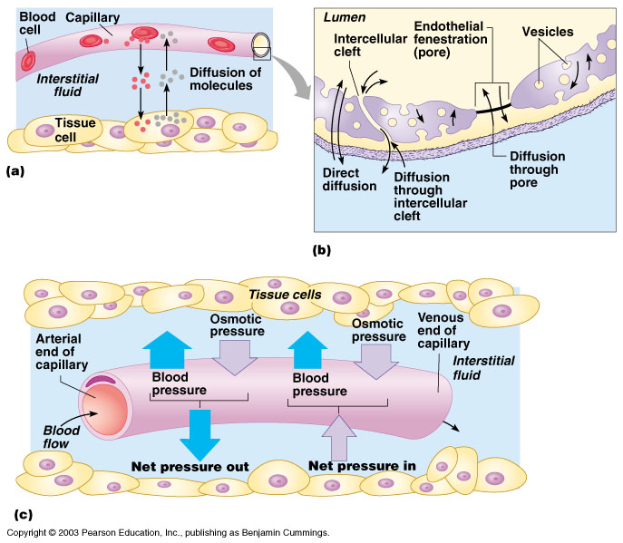
Diffusion at Capillary Beds
Figure 11.20
Copyright © 2003 Pearson Education, Inc. publishing as Benjamin Cummings
Slide 11.29

Slide 44
Vital Signs
Arterial pulse
Blood pressure
Repiratory Rate
Body Temperature
All indicate the efficiency of the system

Slide 45
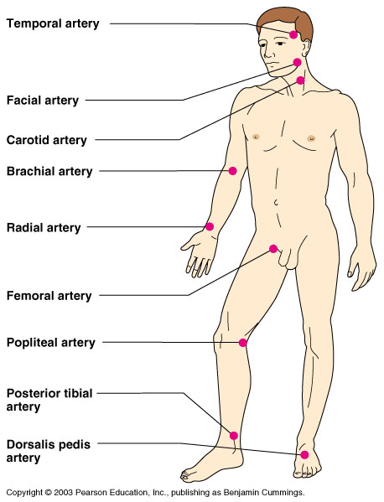
Pulse
Pulse – pressure wave of blood
Monitored at “pressure points” where pulse is easily palpated
Figure 11.16
Copyright © 2003 Pearson Education, Inc. publishing as Benjamin Cummings
Slide 11.35

Slide 46
Blood Pressure
Measurements by health professionals are made on the pressure in large arteries
Systolic – pressure at the peak of ventricular contraction
Diastolic – pressure when ventricles relax
Pressure in blood vessels decreases as the distance away from the heart increases
Copyright © 2003 Pearson Education, Inc. publishing as Benjamin Cummings
Slide 11.36

Slide 47
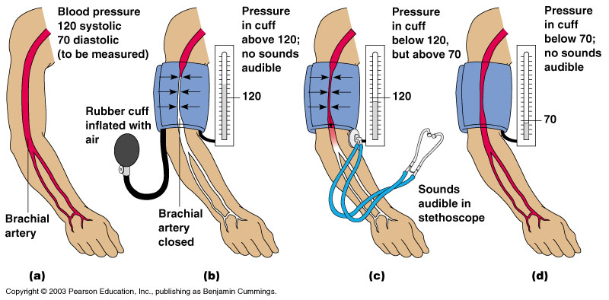
Measuring Arterial Blood Pressure
Figure 11.18
Copyright © 2003 Pearson Education, Inc. publishing as Benjamin Cummings
Slide 11.37

Slide 48
Blood Pressure: Effects of Factors
Neural factors
Autonomic nervous system adjustments (sympathetic division)
Renal factors
Regulation by altering blood volume
Renin – hormonal control
Copyright © 2003 Pearson Education, Inc. publishing as Benjamin Cummings
Slide 11.39a

Slide 49
Blood Pressure: Effects of Factors
Temperature
Heat has a vasodilation effect
Cold has a vasoconstricting effect
Chemicals
Various substances can cause increases or decreases (Can you think of an example?)
Diet
Copyright © 2003 Pearson Education, Inc. publishing as Benjamin Cummings
Slide 11.39b

Slide 50
Variations in Blood Pressure
Human normal range is variable
Normal
140–110 mm Hg systolic
80–75 mm Hg diastolic
Hypotension
Low systolic (below 110 mm HG)
Often associated with illness
Hypertension
High systolic (above 140 mm HG)
Can be dangerous if it is chronic
Copyright © 2003 Pearson Education, Inc. publishing as Benjamin Cummings
Slide 11.41

Slide 51
Recap!
What is cardiac output?
Diastole vs systole
Veins vs Arteries
What are your vitals?
What are some examples that affect blood pressure?
Normal blood pressure range?

