Slide 1
Finding the area of a Regular Polygon
Ms. Mougharbel

Slide 2
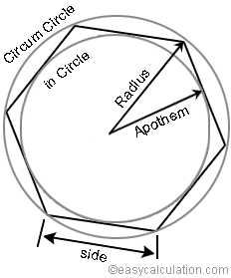
Regular Polygon Terminology
Perimeter [P] – The sum of the lengths of all the sides.
P = (n)(s)
*s = side lengths
Apothem [a] – A segment that joins the polygons centroid to the midpoint of any side that is perpendicular to that side.
Radius [r] – A segment that bisects any interior angle of a regular polygon and meets at the centroid.
Area of a polygon = (1/2)(P)(a)

Slide 3
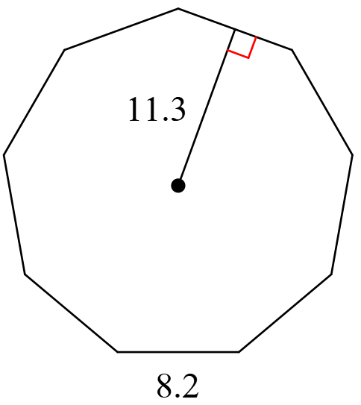
Example Problem #1 – Find the Area
A = (1/2)(P)(a)
A = (1/2)(P)(11.3) P = (8.2)(9) = 73.8
A = (1/2)(73.8)(11.3)
A= 416.97 or 417

Slide 4
What if I am not given the side length?!
If only given the apothem…
s = (a)(2)(tan(180/n))
If only given the radius…
s = (2)(r)(sin(180/n)
Quick Basic Trigonometry Review!
Tan = Opposite/Adjacent
Sin = Opposite/Hypotenuse
Cos = Adjacent/Hypotenuse

Slide 5
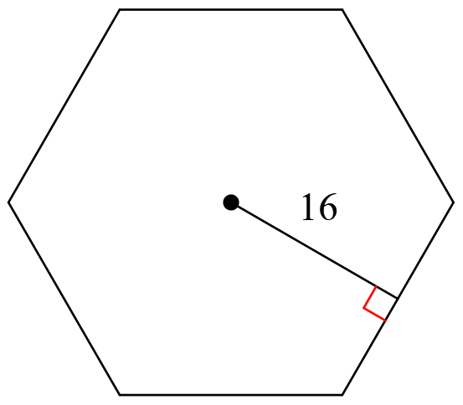
Example Problem #2 – Find the area
A = (1/2)(P)(a) → A = (1/2)(P)(16) → A = (1/2)(111)(16) = 888
P = (n)(s) → P = (6)(s) → P = (6)(18.5) = 111
s = (a)(2)(tan(180/n)) → s = (16)(2)(tan(180/6)) → (32)(tan(30)) = 18.5

Slide 6
What if I am not given the apothem?!
If I am only given the side length…
a = (s)/(2tan(180/n))
If I am only given the radius…
a = (r)(cos(180/n))

Slide 7
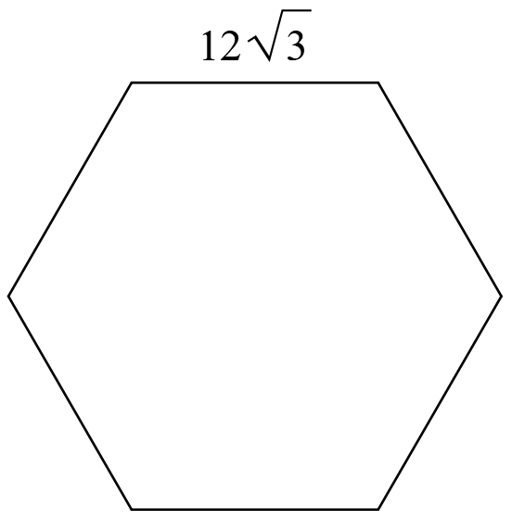
Example Problem #3 – Find the area
A = (1/2)(P)(a) → A = (1/2)(124.7)(18.07) = 1126.7
P = (12$√3$)(6) = 72$√3$ or 124.7
a = (s)/(2tan(180/n) → a = (12$\sqrt{3}$)/(2tan(180/6) → a = (12$√3$)/(2tan(30)) = 18.07

